Slide 1

Talk²Us
Providing care – faster and better.
Hungry Hakkers

Slide 2
How do we treat our elderly?
Residential aged care is notorious for being:
Understaffed
Slow
Stressful
Unaccommodating
Nursing home patients need faster and better responses from staff

Slide 3
What is Talk²Us?
A tool for assistance and request calls for our loved ones in nursing homes.
Streamlines interactions and catering
Provides faster response times
Optimises patient prioritisation
Reassures patients that they have been acknowledged

Slide 4
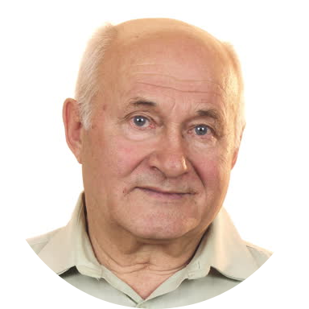




Talk²Us streamlines the Request Journey
Stage 1
Stage 2
Stage 3
Stage 4
Harold is dehydrated and needs nurse assistance
Harold can’t speak English, and presses the ‘help’ button
Request is sent to console and nurses are notified of priority
Nurses acknowledge and reply
Vaccine
Preventable
7.5%
1
2
3
4
Harold
Patient encounters relatively common problem.
Patient communicates non-verbally to nursing staff about their specific issue.
Reduce communication and avoid language barriers
Provide reassurance to patient and notify staff of problems to assist prioritisation.

Slide 5
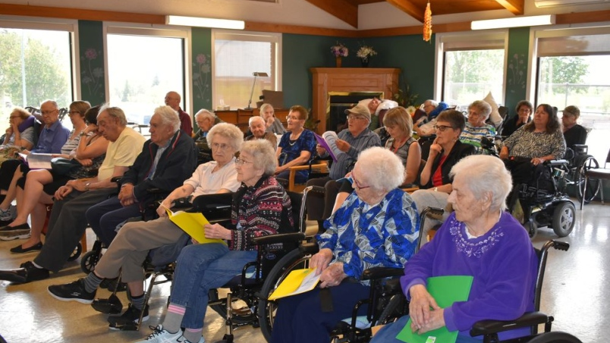
Talk²Us Demo

Slide 6
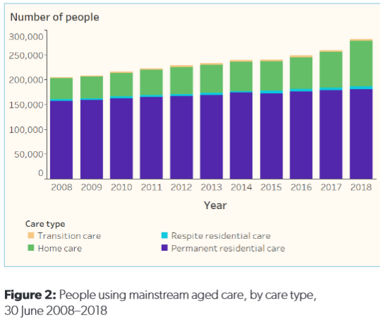
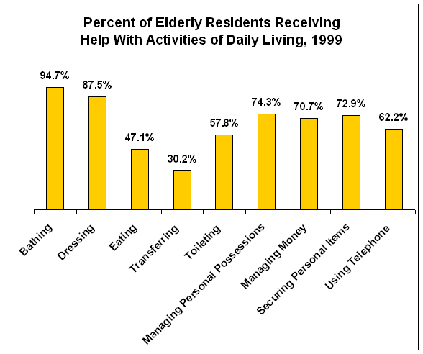
So… why care?

Slide 7
Business Model
Talk²Us
Customers
Users
Subscription software
Installation
Maintenance
Aged Care Providers
Residence homes
Nursing homes
Hospitals
Elderly patients
Speech impediment patients
Chronic illnesses
Cost Structure
Revenue Streams
Key Metrics – Q1 (Business)
Website: $1000 creation + $100 hosting
Marketing: $3000
App development: $15,000
Business Structure: $600
Account: $1000
Government subsidies
Residence homes
Aged care providers
Subscription revenue
Hospitals
Testing with 50% of residents at a nursing home.
30-Day Free Trial
5 Controlled Trials
200 Marketing Emails

Slide 8
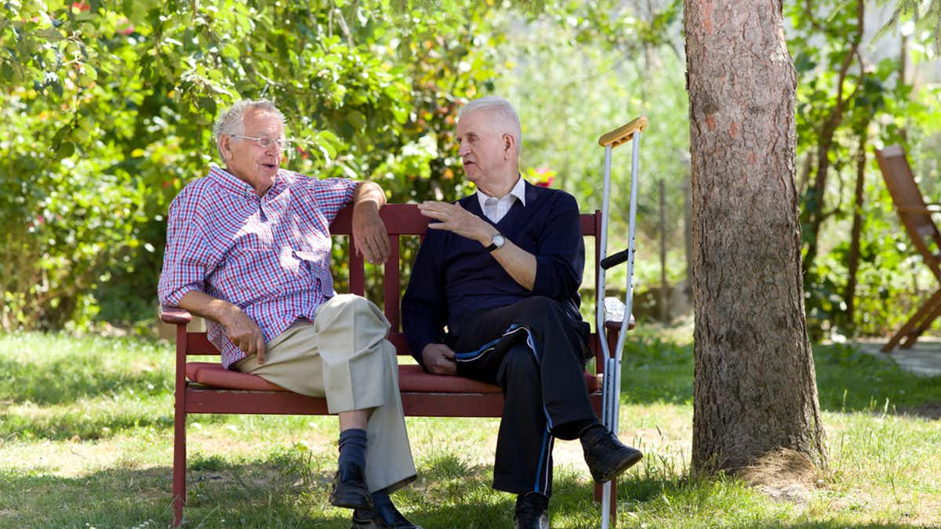
Q&A

